Slide 1
Git
Mango Chen
2013/05/03

Slide 2
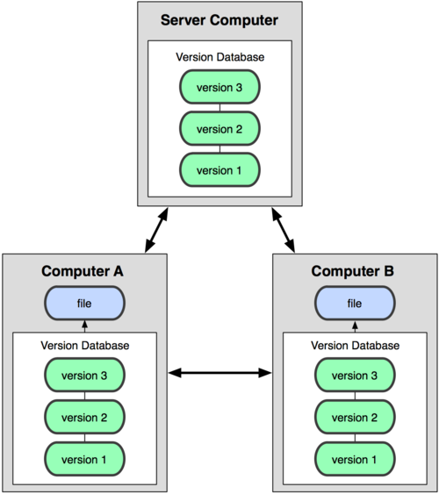
Git is a Distributed Version Control System

Slide 3
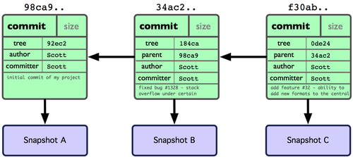
Git Basics
Each commit is a Snapshots, Not Differences
Everything in Git is check-summed before it is stored and is then referred to by that checksum, like below
24b9da6552252987aa493b52f8696cd6d3b00373

Slide 4
Git Basics
Nearly Every Operation Is Local
Git has three main states that your files can reside in
committed : the data is safely stored in your local database
modified : the file is modified but have not committed it to your database yet
staged : a modified file is marked in its current version to go into your next commit snapshot

Slide 5
Git Basics
git add - add file contents to the index
git commit - record changes to the repository
git push - update commit to remote server
git clone - clone a repository into a new directory
repo sync - clone all project to local pc
Three Main setction of git projects
Working Directory - a single checkout of one version of the project
Staging Area(Index) - a simple file, generally contained in your Git directory, that stores information about what will go into your next commit
Repository(git directory) - stores the metadata and object database for your project

Slide 6
Git Basics – Work Flow
f
Local Computer
File status
Working Directory
modified
git add
Staging Area(Index)
staged
git commit
Local Repository
committed
repo sync or
git clone/fetch
git push
Remote Server
Remote Repository

Slide 7
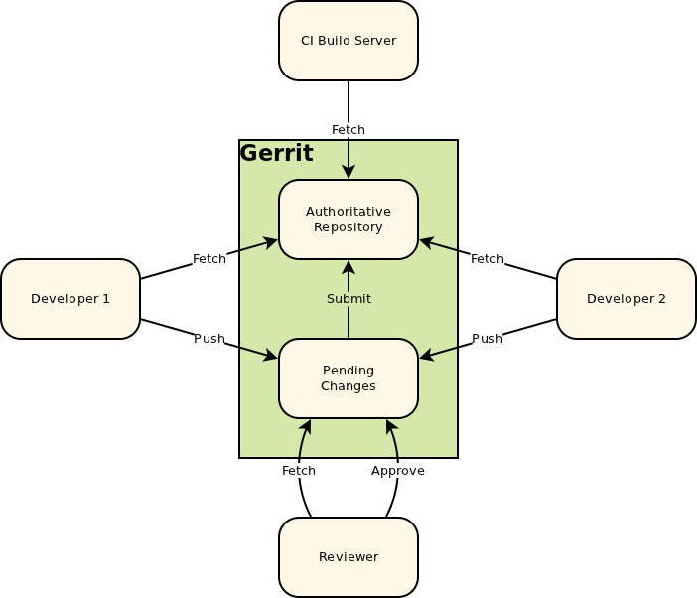
Git Basics – Work Flow with Gerrit
Gerrit adds an additional concepts, a store of pending changes
Developers still fetch code from remote server(repository), but instead of pushing back to it, they push to this pending changes
A change can only be auto submitted into the server once the change has been reviewed and approved

Slide 8
Git Basics - Scenario
hcgit(remote)
aosp/ jb-mstar-master
98ca9
34ac2
f30ab
repo init
repo sync
git checkout --track aosp/jb-mstar-master
98ca9
34ac2
f30ab
jb-mstar-master
my pc(local)
HEAD

Slide 9
Git Basics
hcgit(remote)
aosp/jb-mstar-master
98ca9
34ac2
f30ab
git branch br_dev #create local branch
git checkout br_dev #switch branch
now, HEAD points to commit f30ab
HEAD
br_dev
98ca9
34ac2
f30ab
jb-mstar-master
my pc(local)

Slide 10
Git Basics
hcgit(remote)
aosp/jb-mstar-master
do some modifications
git add
git commit
Now HEAD points to c2b9e
98ca9
34ac2
f30ab
HEAD
br_dev
98ca9
34ac2
f30ab
c2b9e
jb-mstar-master
my pc(local)

Slide 11
Git Basics
Some one push commit 87ab2 to server
hcgit(remote)
aosp/ jb-mstar-master
98ca9
34ac2
f30ab
87ab2
HEAD
br_dev
98ca9
34ac2
f30ab
c2b9e
jb-mstar-master
my pc(local)
11

Slide 12
Git Basics
hcgit(remote)
aosp/jb-mstar-master
git checkout jb-mstar-master
git pull
Fetch and merge code from server
Now HEAD points to 87ab2
98ca9
34ac2
f30ab
87ab2
br_dev
c2b9e
98ca9
34ac2
f30ab
87ab2
jb-mstar-master
HEAD
my pc(local)

Slide 13
Git Basics
hcgit(remote)
aosp/jb-mstar-master
git merge
merge commit is dlef4
98ca9
34ac2
f30ab
87ab2
br_dev
c2b9e
98ca9
34ac2
f30ab
87ab2
dlef4
jb-mstar-master
HEAD
my pc(local)

Slide 14
Git Basics
hcgit(remote)
c2b9e
git push
98ca9
34ac2
f30ab
87ab2
d1ef4
aosp/jb-mstar-master
git push
br_dev
c2b9e
98ca9
34ac2
f30ab
87ab2
d1ef4
jb-mstar-master
my pc(local)
HEAD

